Slide 1
Looping Constructs & Iteration
Visual Basic

Slide 2
Table OF contents
Lecture context
Typical flow sequences
While loop
do loop
Flowchart - For next Loop
For next stepping
Problems with looping
Nested loops

Slide 3

Lecture context
Understand the power of the second structured programming technique (iteration)
See why we need looping constructs to create powerful, flexible programs
Be familiar with several looping constructs used in Visual Basic and their usage
Understand what is meant by nesting and the type of problem that requires its use

Slide 4
Lecture context
The most powerful construct of the three available to a programmer is iteration – the ability to repeat an operation for a either a predetermined number of cycles or until some stimulus occurs or condition is met.
Write a few lines instead of thousands!! This is particularly useful in engineering when one is often processing groups of data stored in arrays (matrices).
Programming languages typically offer several iterative constructs with slightly differing functionality for varying tasks and VB2010 is no exception.

Slide 5
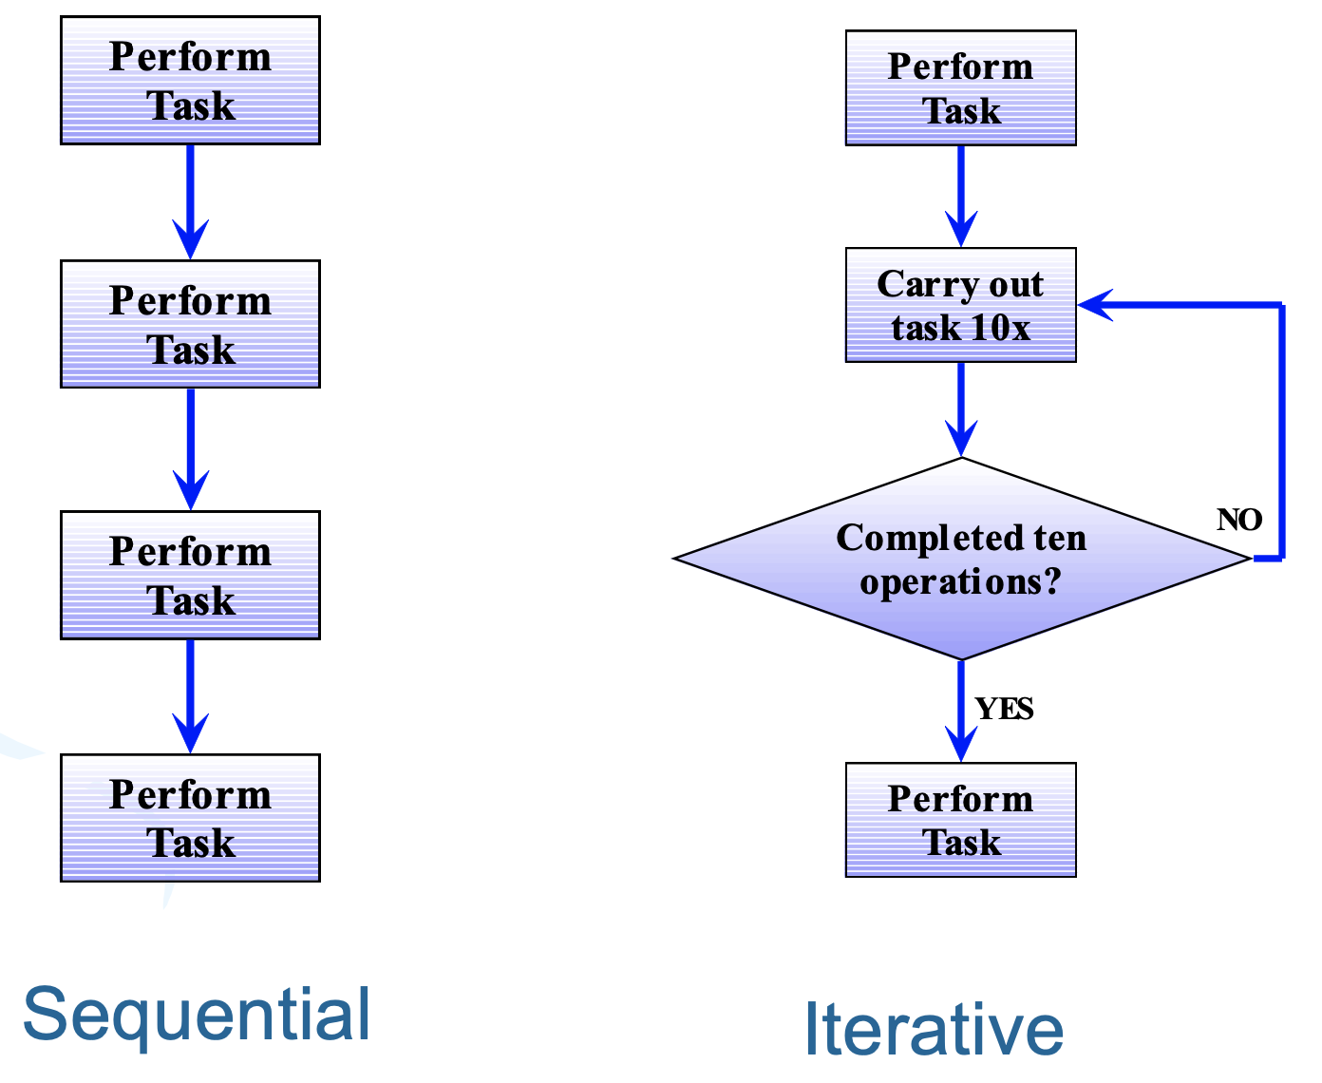
Typical flow sequences

Slide 6
While loop
Repeated execution until some condition is met
Comparisons for all constructs x>y, x<y, x=y, x<>y
Begins with While keyword, ends with End While
Test performed before code is run
If condition false before loop entry, code not run
If condition never met in loop then it runs until program is terminated - use exit sub x
While (condition)
Insert user code here
End While ‘go back to start of loop until condition met

Slide 7
While loop
- May prematurely leave the loop if desired using Exit keyword:
- Exit While

Slide 8
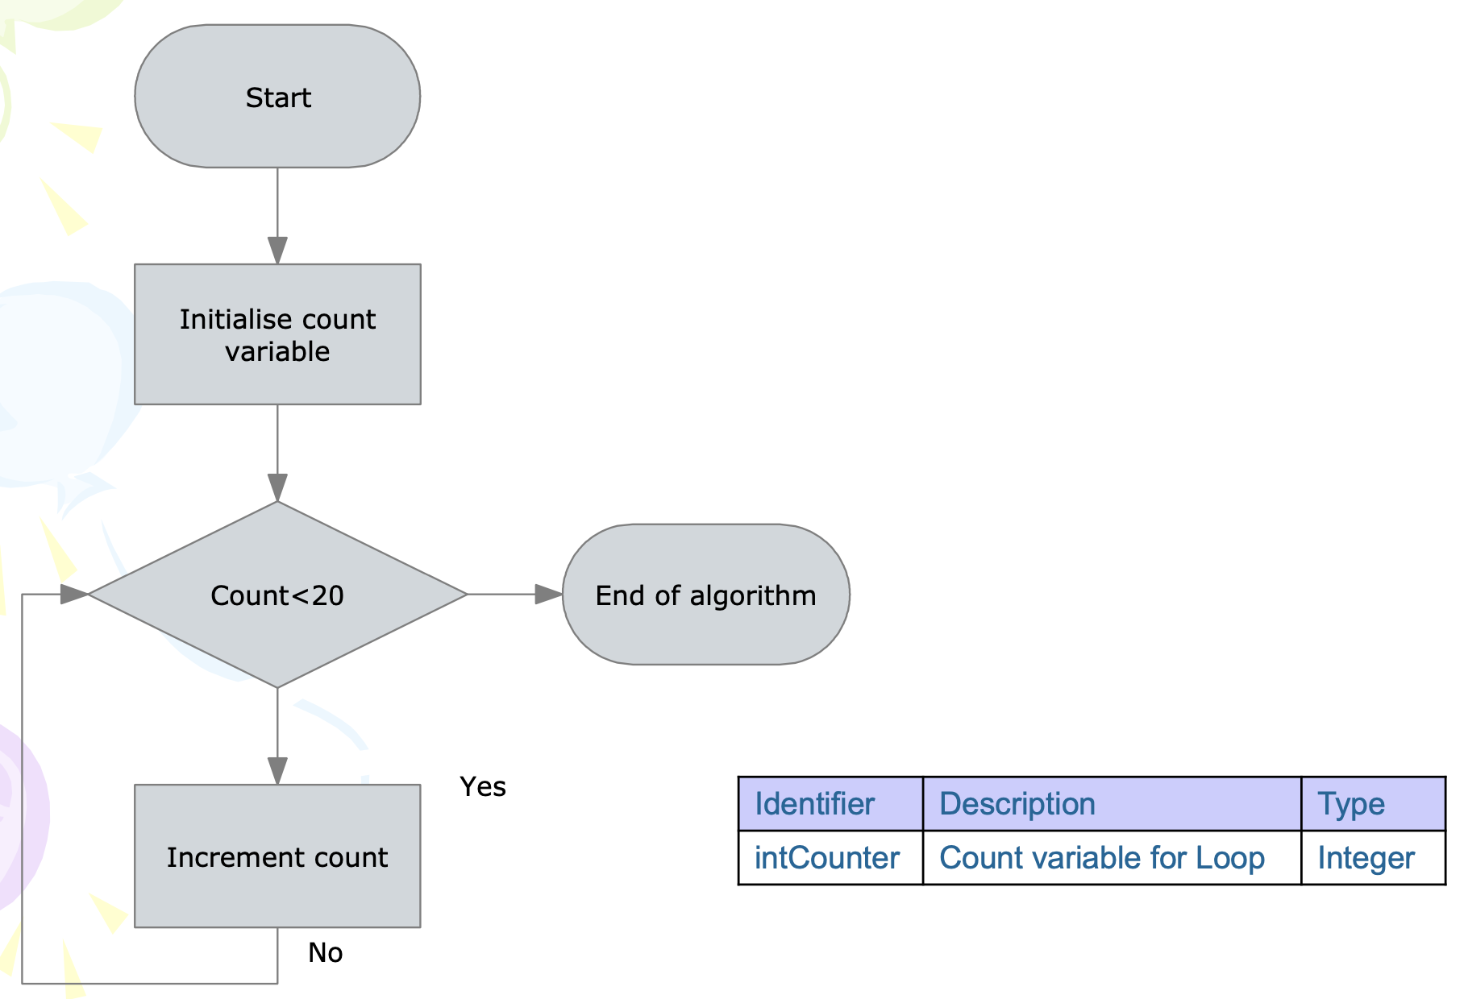
While loop

Slide 9
do loop
The test is performed at end of the loop
Will always run at least once, even when the condition was met before the code is reached
We may prematurely exit using Exit Do
Begins with the Do keyword and ends with Loop While or Loop Until
Similar to do while loops in other programming languages
Do
Insert user code here Loop While (until) ( test condition met/not met)

Slide 10
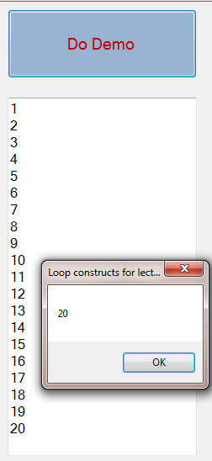
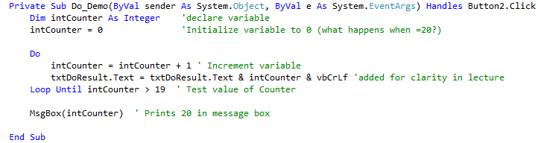
do loop
May prematurely leave the loop if desired using Exit keyword:
Exit Do

Slide 11
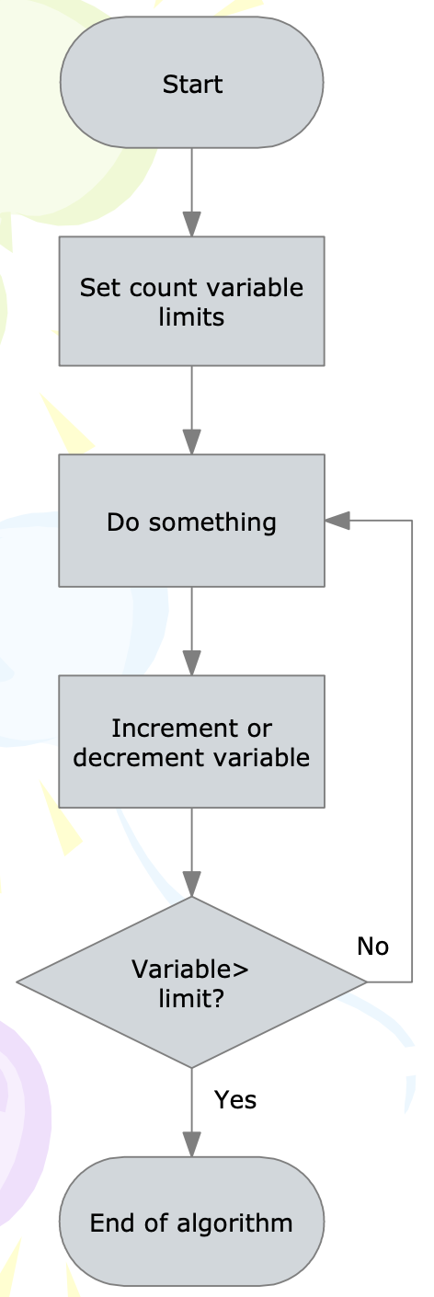
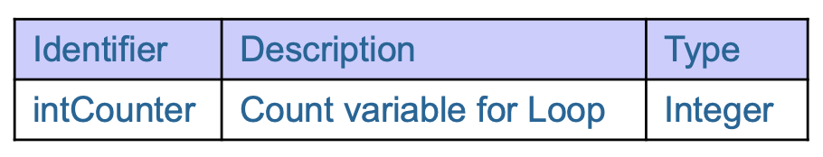
Flowchart - For next LOOp
When the loop is exited, the count variable is one more count than the upper limit as the variable increment/decrement takes place on the ‘Next’ instruction.

Slide 12
For next stepping
To decrement use Step argument with negative values eg. step -1
Step sets size of increment – can be decimals e.g. step 0.1
User code will be run 10 times
For intCounter = 18 to 0 Step -2
Insert user code here
Next

Slide 13
FOR NEXT loop
- May prematurely leave the loop if desired using Exit keyword:
- Exit While

Slide 14
Problems with looping
When iterating, processor load = 100%
Windows cannot perform house-keeping tasks – update screen etc.
Correct way to handle is multi-threading in your programs: can do, but complicated!!
Application.DoEvents releases system for housekeeping during looping
Do Some code repeatedly
Application.DoEvents ‘let windows do its thing Loop While (condition not met)

Slide 15
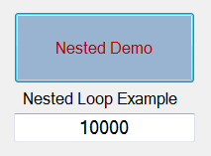
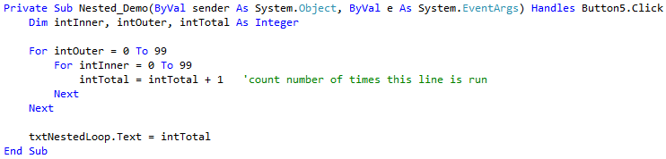
Nested loops
Loops around 100 x 100 = 10,000 times!

Slide 16
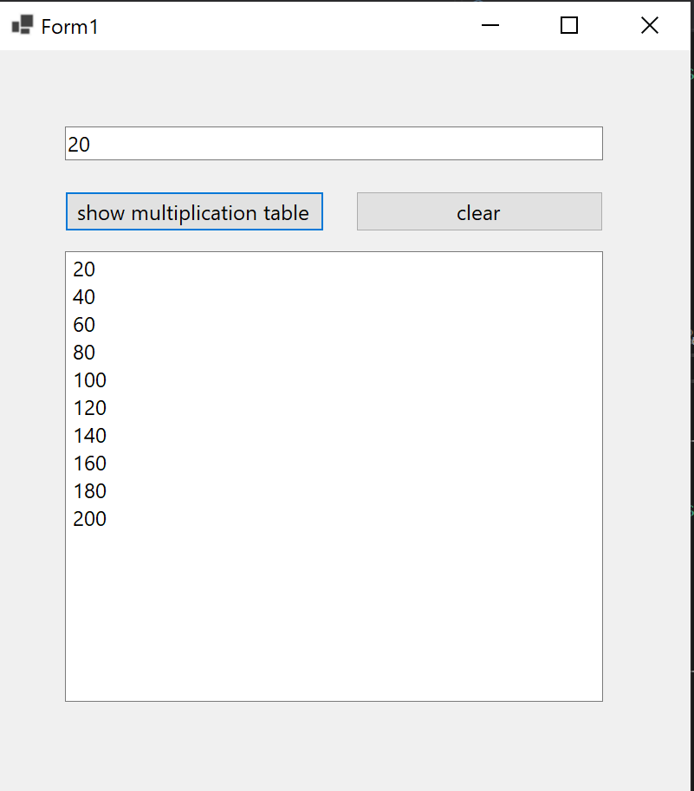
EXERCISE (15 – 20 minutes)
To create a mini application
We are going to create a multiplication table
When I click the multiplication table it should generate the 1st 10 numbers of the multiplication table for this number.
When I click clear it should clear all the values inside the table.
We assume only valid numbers to be added into the textbox.

Slide 17
Heads up for your exercise
You need to convert the datatype inside the textbox from string to integer in order for this project to work.
Do use the reference link below to help you get started.
https://www.convertdatatypes.com/Convert-Single-to-Integer-in-VB6-VBA.html

